Slide 1

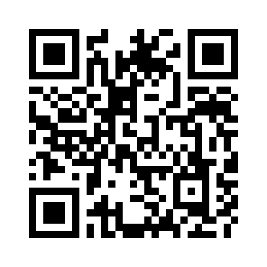
Toward the Holy Grail of Automated Fact-checking
Chengkai Li
Department of Computer Science and Engineering
University of Texas at Arlington
Google, NYC, May 3rd, 2017

Slide 2
Our Society’s Struggle with Falsehoods
Politicians make false and misleading claims all the time.
Fact-checks on major party presidential nominees.
Source: PolitiFact.com

Slide 3
Our Society’s Struggle with Falsehoods
Politicians make false and misleading claims all the time.
Fake-news floods the Internet; exacerbated by social media (“filter bubbles” and “echo chambers”).
Facebook trend topic algorithms promoted fake-news.
A sample of 140,000 Twitter users in the battleground state of Michigan shared as many junk news items as professional news during the final ten days of the 2016 election. http://politicalbots.org/?p=1064
National security threats:
U.S. intelligence community concluded that the Russian government interfered with the 2016 election. Fake-news websites and bots used.
“Pizzagate”

Slide 4
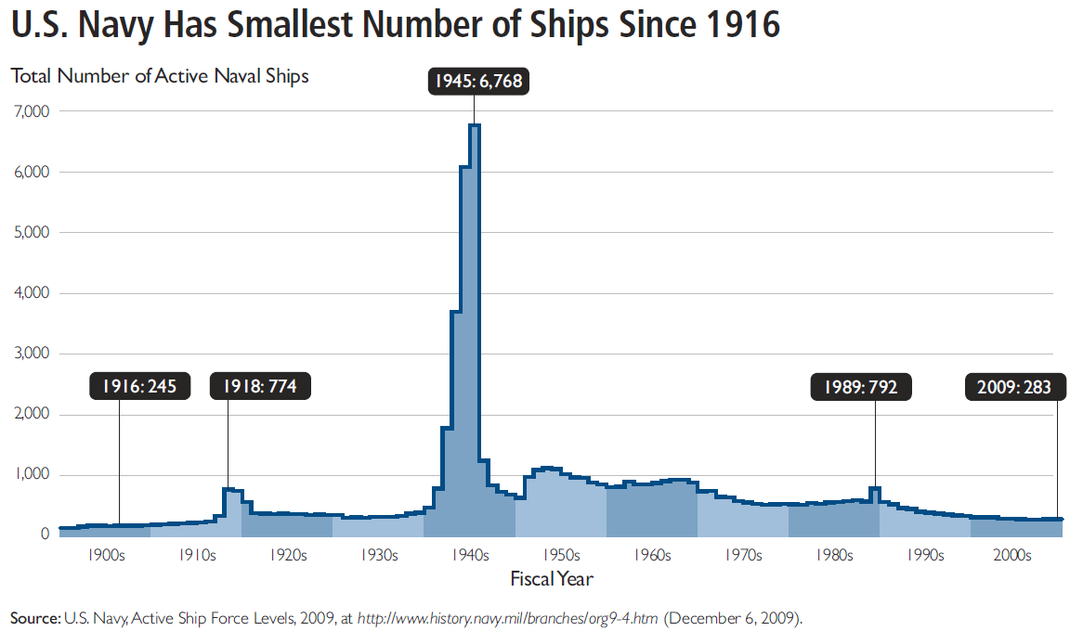
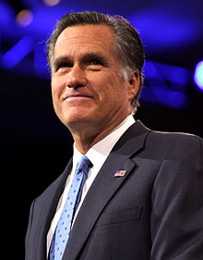
Fact-checking is Hard
“… our Navy is smaller than it's been since 1917", said Republican candidate Mitt Romney in third presidential debate in 2012.
http://en.wikipedia.org/wiki/Mitt_Romney
http://s3.amazonaws.com/thf_media/2010/pdf/Military_chartbook.pdf

Slide 5

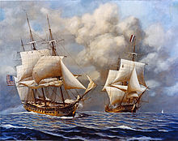
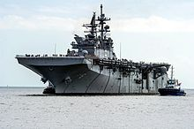
Fact-checking is Hard
“… our Navy is smaller than it's been since 1917", said Republican candidate Mitt Romney in third presidential debate in 2012.
vs
http://en.wikipedia.org/wiki/Mitt_Romney
http://s3.amazonaws.com/thf_media/2010/pdf/Military_chartbook.pdf
http://en.wikipedia.org/wiki/United_States_Navy

Slide 6
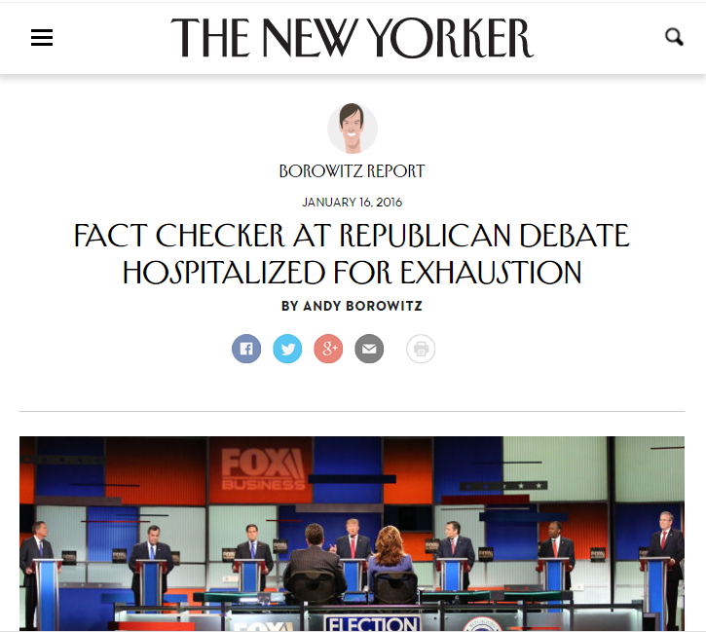
Fact-Checking is Time-Consuming and Resource-Demanding
satire

Slide 7
Combating Falsehoods
Initiatives by Google, Facebook, and others
100+ active fact-checking sites in 2017 (PolitiFact.com, FullFact.org, CNN, Washington Post, New York Times, …)
Google includes fact-checks in search results.
Facebook lets users report false items and flags items disputed by fact-checkers.
Three categories of algorithm-based approaches
Leveraging experts’ verdicts
Trait-based (rumor detection)
Data-driven, algorithmic

Slide 9
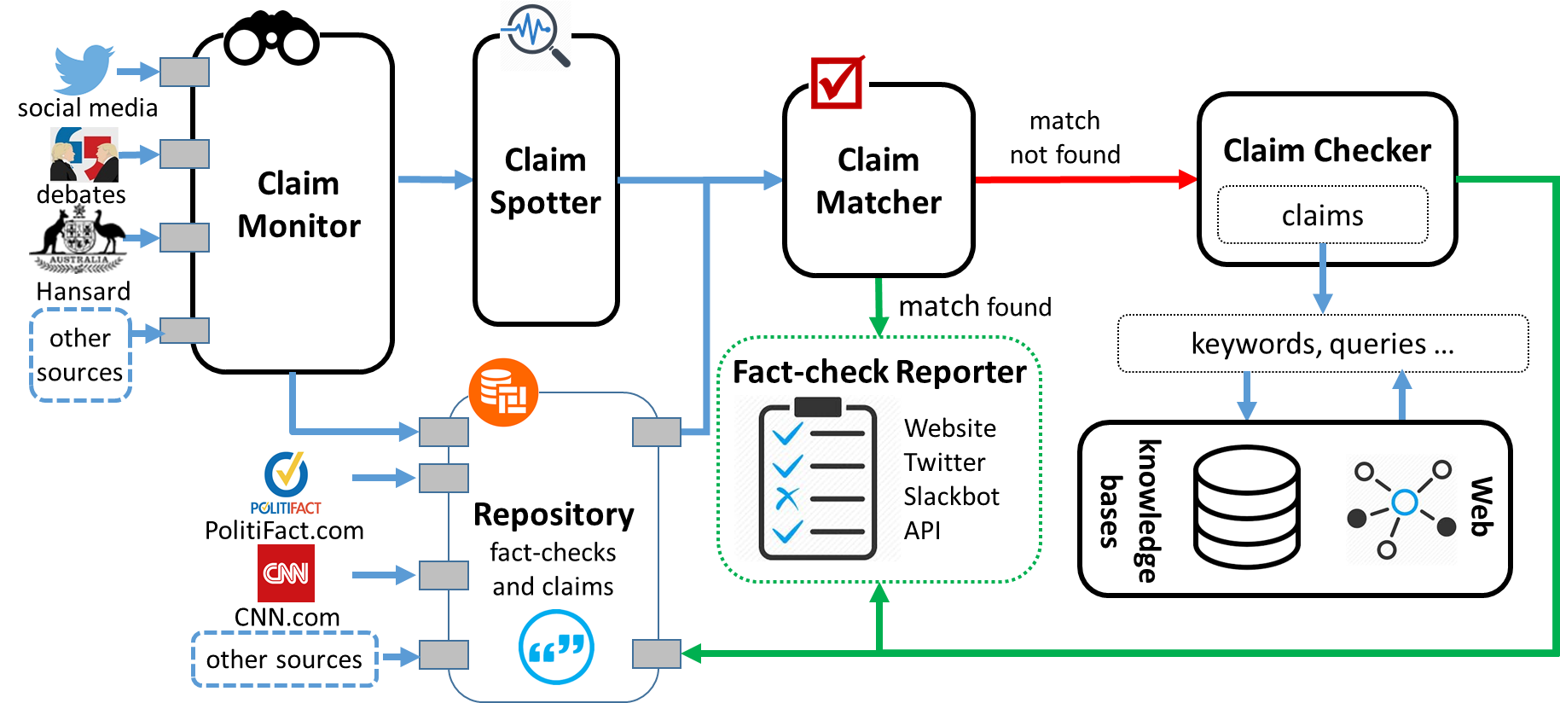
The First-ever End-to-end System

Slide 10
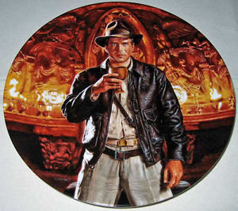
The Holy Grail: Automated, Live Fact-Checking

Slide 11
Proof of Concept: PolitiFact Fact-check Popup
Source: Duke Reporters’ Lab

Slide 12
idir.uta.edu/claimbuster

Slide 13
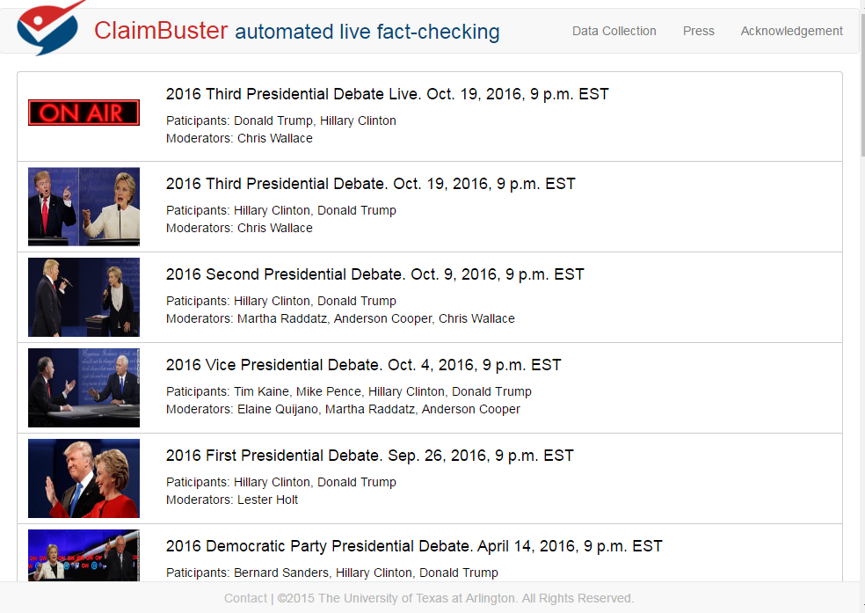

Slide 14
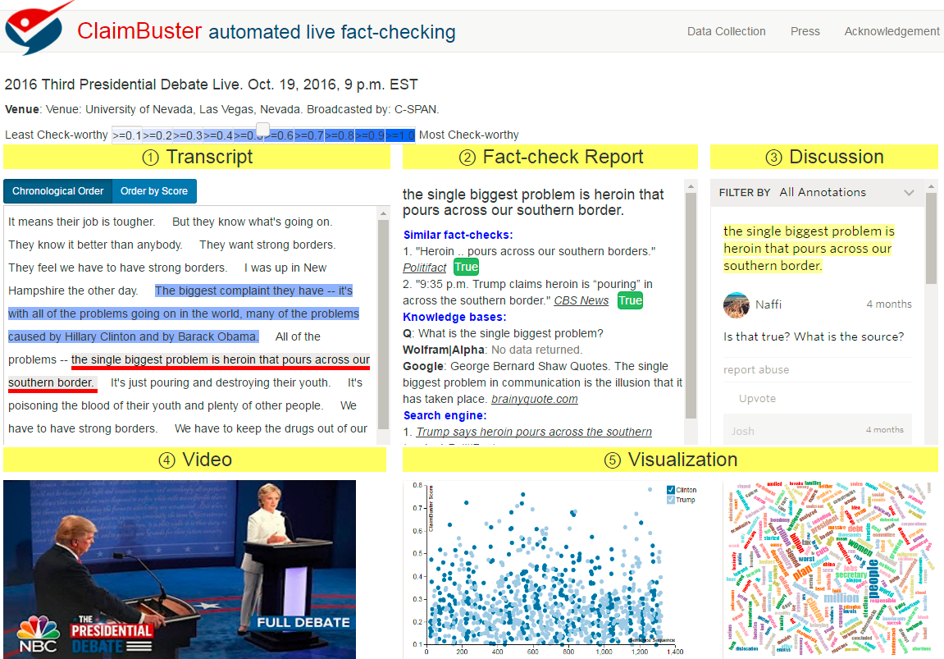

Slide 16
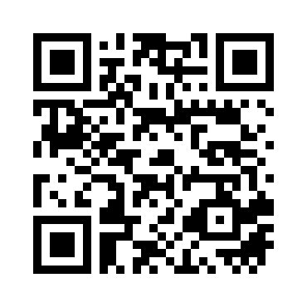
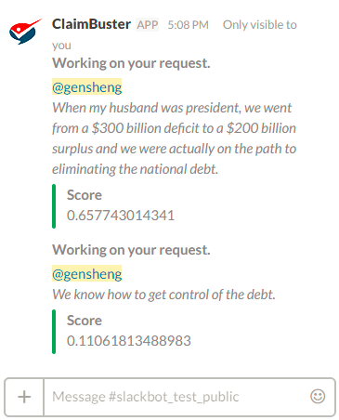
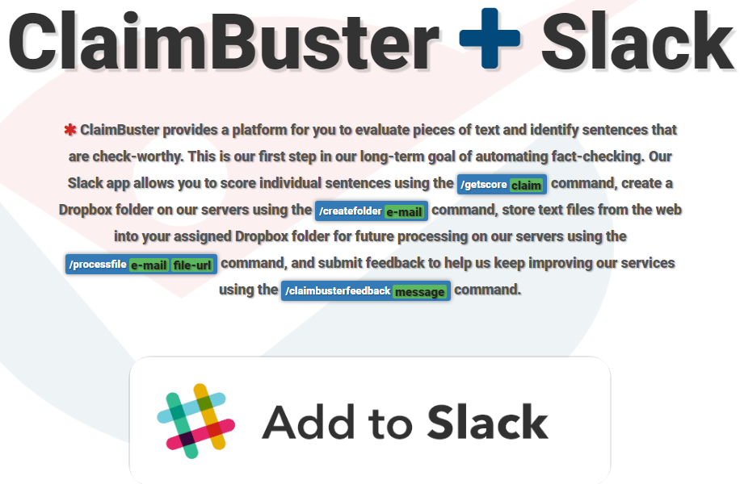

Slide 18
Claim Spotter

Slide 19
The First-ever End-to-end System

Slide 20
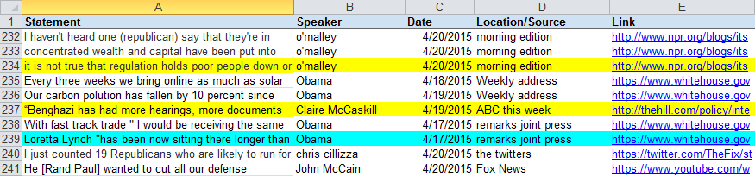
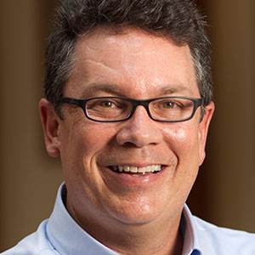
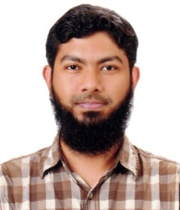
PolitiFact “Buffet” of Factual Claims
2014
This is what they eat at PolitiFact.
Let me work on its automation.

Slide 21
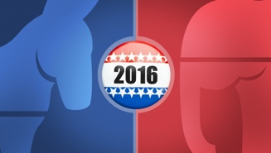




Finding Important Factual Claims:
A Supervised Learning Task
2016
Presidential
Debates
Human Annotation
Feature Extraction
Learning Algorithm
Ground Truth
Feature Vectors
Presidential Debate Transcripts (1960-2012)
Important factual claims

Slide 22
Dataset: Presidential Debate Transcripts
Source: http://www.debates.org/index.php?page=debate-transcripts
All 30 debates (11 general elections) in history: 1960, 1976—2012
20k sentences by presidential candidates: removed very short (< 5 words) sentences

Slide 23
3 Classes of Sentences
CFS: Important factual claims
“We spend less on the military today than at any time in our history.” “The President’s position on gay marriage has changed.” “More people are unemployed today than four years ago.”
UFS: Unimportant factual claims
“I was in Iowa yesterday.” “My mother enjoys cooking.” “I ran for President once before.”
NFS: No factual claims (just opinions, questions & declarations)
“Iran must not get nuclear weapons.” “7% unemployment is too high.” “My opponent is wishy-washy.” “I will be tough on crime.” "Why should we do that?“ “Hello, New Hampshire!” “Our plan is to reduce tax rate by 10%.”

Slide 24
3 Classes of Sentences
If a sentence contains an opinion and an important factual claim, it shouldn’t be labelled “No factual claims”.
“Unemployment rate is too high and in last four years it increased from 8% to 10%.”

Slide 25
Ranking and Classification Problems
Classification
Given a future sentence, find the class it belongs to.
Ranking
Rank sentences based on how likely they contain important factual claims.

Slide 26
Feature Extraction
Word:
state, legislature, 87, percent, democrat
Sentiment: 0.032
I was in a state where my legislature was 87 percent Democrat.
Part-of-Speech:
Noun
Entity Type:
Quantity
Concept:
United States
Sentiment: [-1.0 to 1.0]
Word: tf-idf scores of 6130 words (excluding rare words)
POS Tag: 43 tags
Entity Type: 26 types

Slide 27
Feature Importance
6615 features in total
Used a Random Forest Classifier to calculate the importance of each feature.
Word | percent; people; jobs
POS Tag | noun; cardinal number; past tense; preposition
Entity Type | Quantity; Country; FieldTerminology; Person
Concept | United States Senate; Barack Obama
Sentiment

Slide 28
Evaluation: Classification
4-fold cross validation
Methods: Naive Bayes (NBC), Random Forest (RFC), Support Vector Machine (SVM)
In general, SVM, using Word + POS, performed better than other combinations.
 | Precision | Recall | F-measure
NFS | 0.90 | 0.96 | 0.93
UFS | 0.65 | 0.26 | 0.37
CFS | 0.79 | 0.74 | 0.77

Slide 29
Comparison with Subjectivity Classifiers

Slide 30
Evaluation: Ranking
NBC, RFC, SVM all allow ranking.
Accuracy of top-K sentences ranked by ClaimBuster, using the admitted sentences from top-coders as ground truth.
ClaimBuster has a strong agreement with top-quality human coders on the check-worthiness of sentences.

Slide 31
Case Study: 2016 U.S. Presidential Election Debates

Slide 32
Live Coverage of Debates
Extracted closed captions of debates on broadcast TV channels using TextGrabber
Finding speaker identity using Twitter
Tweeted important factual claims to https://twitter.com/ClaimBusterTM, live!

Slide 33
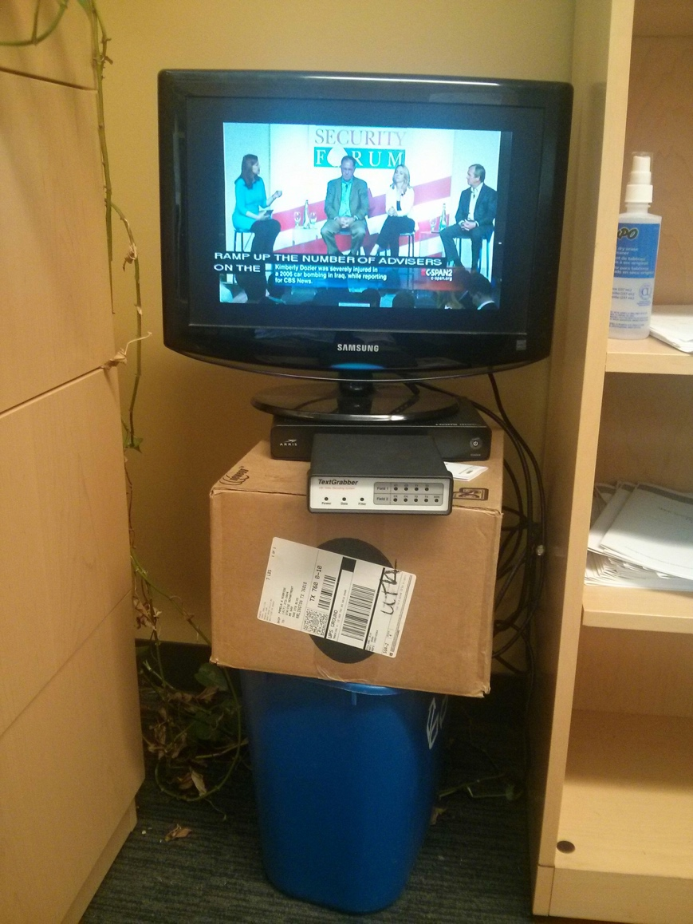
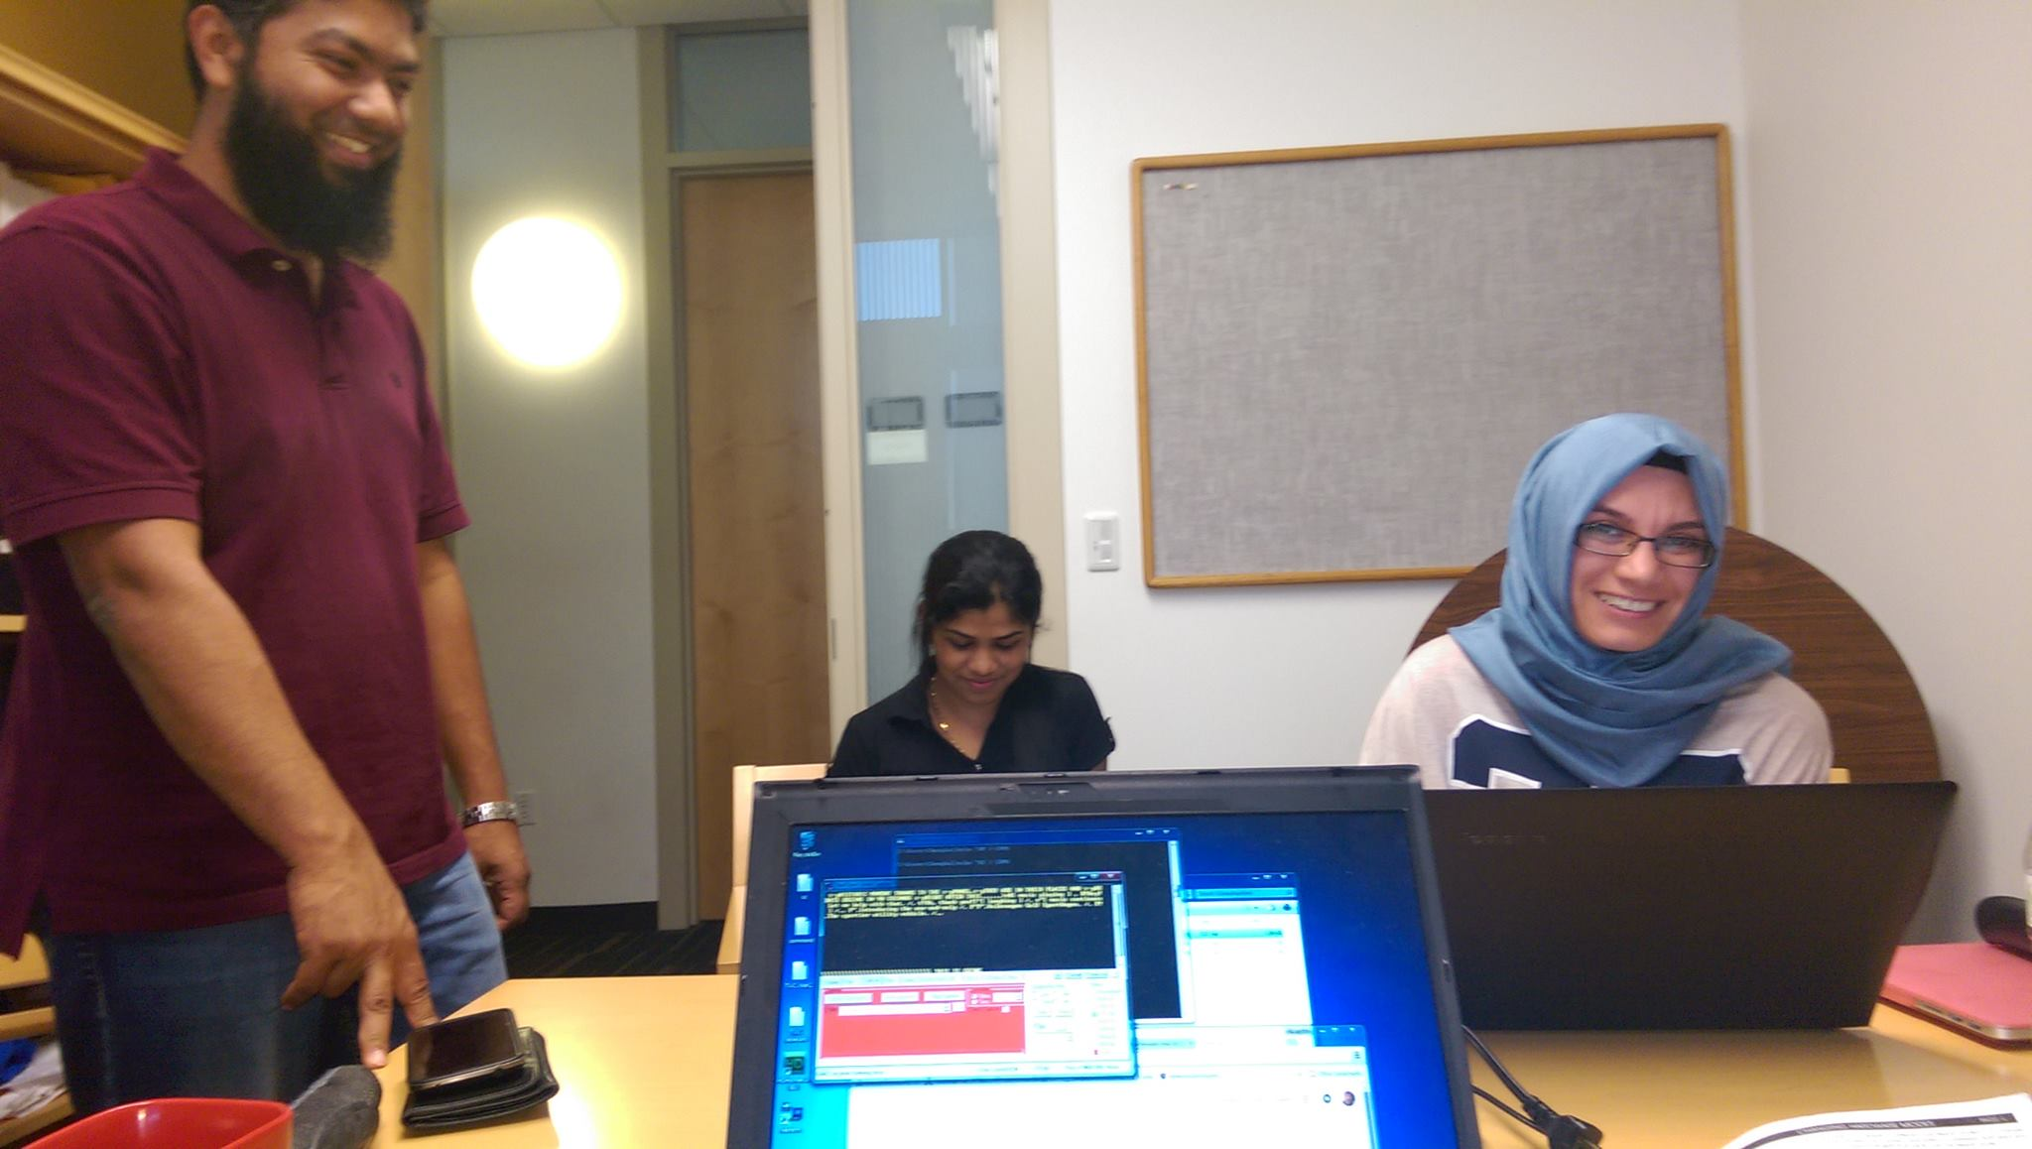

Slide 34
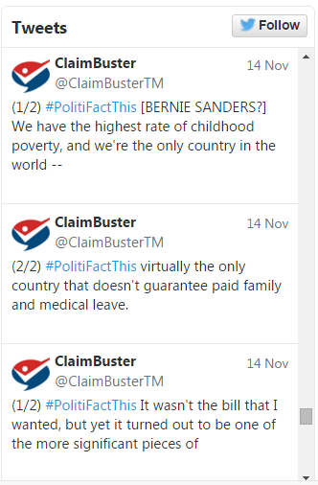
Claims Tweeted

Slide 35
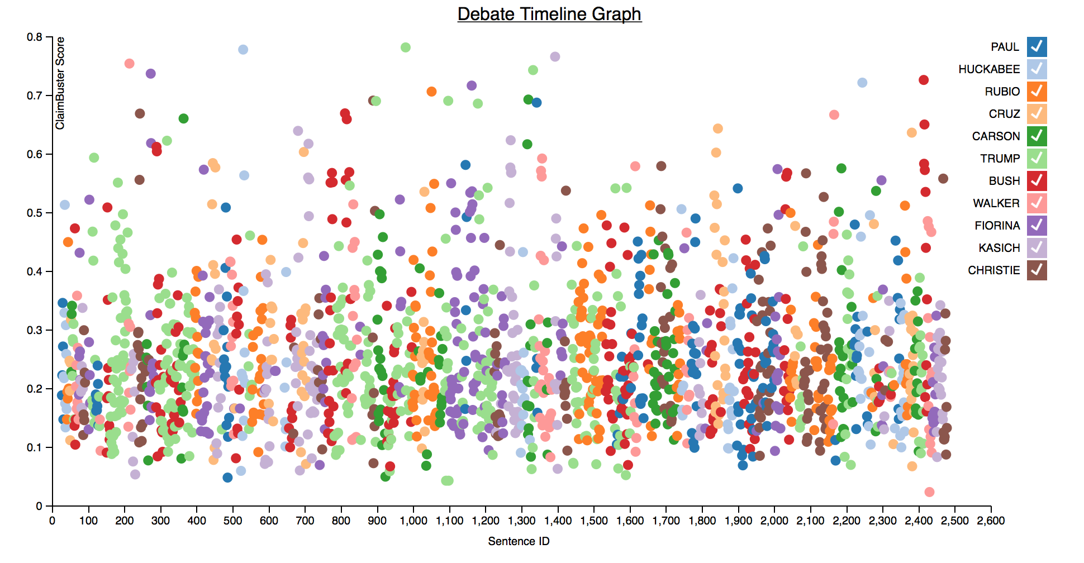

Slide 36
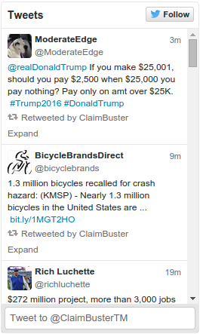
Retweeting Claims in Tweets

Slide 37
Ground-Truth Collection

Slide 38
Our Own CrowdFlower

Slide 39
Coder Quality

Slide 40
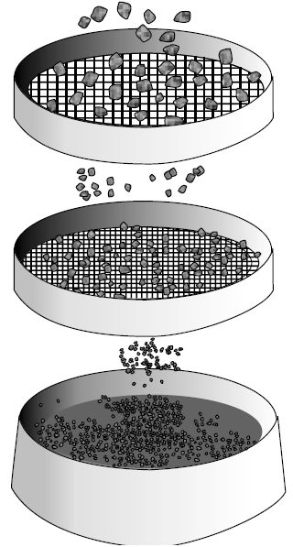
Ground Truth Collection
20 months
~$4,000 paid
1032 screening sentences (by 3 experts) to detect spammers & low-quality coders
376 coders
76552 labels
88 top-quality coders
52333 labels
Class | Count | Percentage
CFS | 4187 | 23.70%
UFS | 1627 | 9.21%
NFS | 11851 | 67.08%
88 top-quality coders
17665 admitted sentences
http://www.engineersdaily.com/2014/03/basics-of-soil-compaction.html

Slide 41
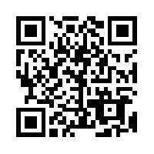
You are Invited to Contribute
http://bit.ly/claimbusters

Slide 42
PolitiTax: A Taxonomy of Political Factual Claims

Slide 43
PolitiTax
Modeling Claims
Can be useful to all relevant ClaimBuster components
Political Factual Claims
Action
Observing Traits
Metric Measurement
Plural Action
Ranking
Quantity Transfer
Capability
Uniqueness of Trait
Existence
Change in Quantity
Relatedness
Ratio
Action During Time
Flip Flop
Vote
Presence in Medium
Comparing Traits
Magnitude of Change in Quantity Over Time
Oppose and Support
Correlation
Speech
Comparing Actions
Comparing Quantities
Causation

Slide 44
Example: Ranking

Slide 45
Claim Matcher

Slide 46
The First-ever End-to-end System

Slide 47
Textual Entailment Algorithms
Textual entailment is defined as a directional relationship between pairs of text expressions, denoted by T (the entailing “Text”) and H (the entailed “Hypothesis”). We say that T entails H if humans reading T would typically infer that H is most likely true.

Slide 48
Preliminary Experiments
Small dataset:
2500 pairs(text&hypothesis): Cross product
Text (50 sentences from 2016 presidential debate)
Hypothesis (50 sentences from Politifact)
Medium dataset:
~7 million pairs(text&hypothesis)
Text (all 2016 presidential debate sentences 32k)
Hypothesis (only debate related sentences from Politifact ~220)
Large dataset:
~35 million pairs (text&hypothesis)
Text (Politifact sentences ~6k)
Hypothesis (2016 presidential debate sentences ~6k)

Slide 49
Preliminary Experiments
EditDistance
TIE (MaxEntClassificationEDA)
 | Precision | Recall
Small Dataset | 0.87 | 1
Medium Dataset | 1 | 0.83
 | Precision | Recall
Small Dataset | 1 | 0.88
Large Dataset | 1 | Ongoing

Slide 50
Acknowledgment
Current/Former UTA Students
Naeemul Hassan
Gensheng Zhang
Fatma Arslan
Josue Caraballo
Damian Jimenez
Siddhantsanjeev Gawsane
Shohedul Hasan
Minumol Joseph
Aaditya Kulkarni
Anil Kumar Nayak
Vikas Sable
Collaborators
Bill Adair (Duke)
Pankaj Agarwal (Duke)
Peter Frays (University of Technology Sydney)
James Hamilton (Stanford)
Mark Tremayne (UTA)
You Wu (Google)
Jun Yang (Duke)
Cong Yu (Google)

Slide 51



Acknowledgment
Funding sponsors
Disclaimer: This material is based upon work partially supported by the National Science Foundation Grants 1408928 and 1565699 and a Knight Prototype Fund from the Knight Foundation. Any opinions, findings, and conclusions or recommendations expressed in this material are those of the author(s) and do not necessarily reflect the views of the funding agencies.

Slide 52
Thank You! Questions?
http://ranger.uta.edu/~cli
cli@uta.edu
Demo
http://idir.uta.edu/claimbuster
Please help us label the data
http://bit.ly/claimbusters

